Slide 1
COMPLICATIONS OF SINUSITIS
Dr.Haval Ahmed Hama
MBChB, F.K.B.M.S
(Otolaryngology, Head and Neck Surgeon)
University of Sulaymaniyah, College of Medicine.
Branch Of Clinical Science.

Slide 2
Sinusitis
Definition of Complications of sinusitis
Classification
Clinical features
Diagnosis
Investigations
Treatment

Slide 3
Definition
A complication of rhino-sinusitis may be defined as any adverse progression of chronic or acute bacterial infection beyond the paranasal sinuses

Slide 4
CLASSIFICATION
Acute:-
Local
Frontal sinus----Pott’s puffy tumor
Ethmoid sinus---- Orbital cellulitis
Maxillary– less common
Sphenoid sinus---Cavernous sinus thrombosis
Notes:
diploeic veins of the frontal and sphenoid bones. Direct extension occurs through congenital bony dehiscences, open suture lines or
foramina, or by erosion through bony barriers (e.g., laminapapyracea)

Slide 5
(b) Distant
Brain abscess
Septicaemia
Toxic shock syndrome
Chronic:-
Mucocoeles > pyocoeles

Slide 6
Clinical classification
Orbital (60-75%) | Intracranial (15-20%) | Bony (5-10%) | Chronic
1. Preseptal cellulitis 2. Orbital cellulitis 3. Subperiosteal abscess 4. Orbital abscess 5. Cavernous sinus thrombosis | Meningitis EpiduraI abscess Subdural abscess Intracerebral abscess 5. Cavernous or sagittal sinus thrombosis | Osteomyelitis (Pott's puffy tumour) | Mucocoele/pyocoele

Slide 7
Orbital Complications
Most commonly involved complication site:
Proximity to ethmoid sinuses
Orbital septum is the only soft-tissue barrier
Valveless superior and inferior ophthalmic veins
Continuum of inflammatory/infectious changes
Direct extension through lamina papyracea

Slide 8
Impaired venous drainage from thrombophlebitis
Progression within 2 days
Children more susceptible?

Slide 9
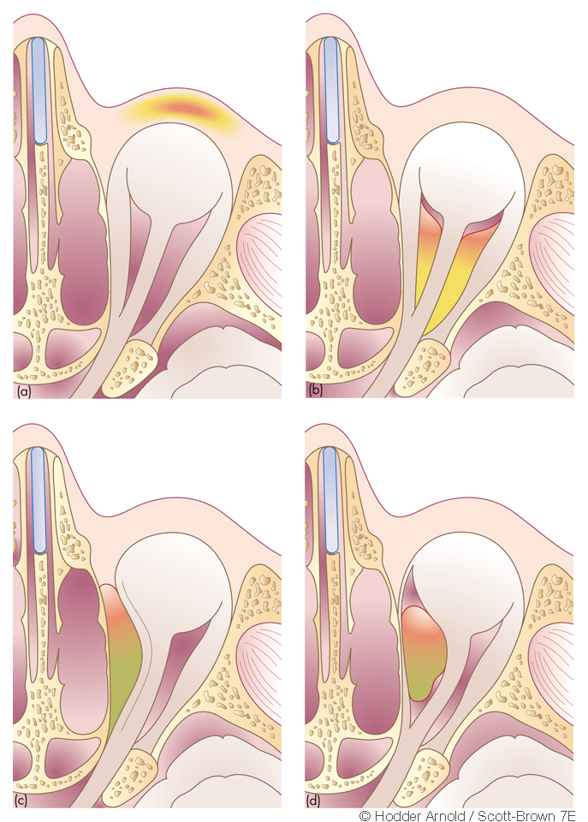
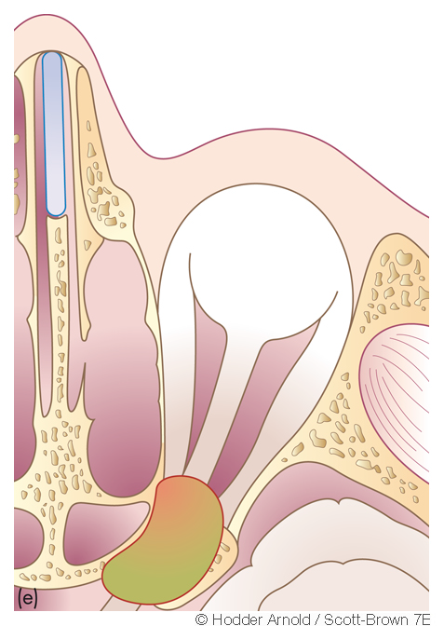
Chandler Classification
Notes:
(a) preseptal inflammation: (b) orbital cellulitis; (c) orbital cellulitis with subperiosteal (extra periosteal) abscess;(d) orbital cellulitis with intraperiosteal abscess. (e) cavernous sinus thrombosis

Slide 10
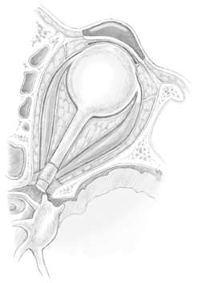
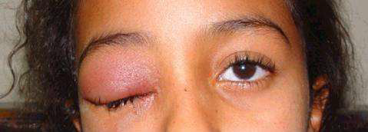
Periorbital cellulitis (Chandler class I)
Most common and least severe
70 to 80% of cases
The edema confined to periorbital eyelid by
the orbital septum
Mild proptosis
Notes:
1.No change in extra-ocular movement or an impairment of vision, Visual problems may be present if the problem is stage three (subperiosteal
abscess) or beyond, and specific enquiries should be made regarding visual acuity and colour vision, problems which might indicate a compromise of optic nerve function.
2.IV broad-spectrum antibiotics and hospital observation ,Warm compresses Facilitate sinus drainage, Nasal decongestants○ Mucolytics○ Saline irrigations

Slide 11
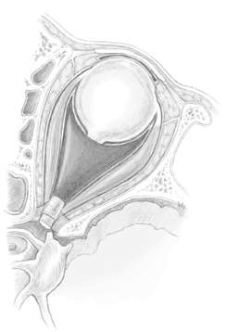
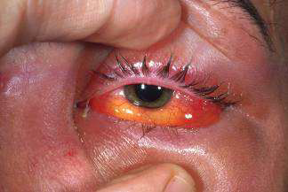
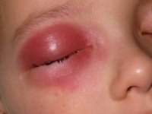
Orbital cellulitis (Chandler class II)
Periorbital swelling
Edema (95%)
Proptosis
No abscess formation
Notes:
1.orbital pain -85 to 89%. Formal assessment colour vision, eye movement, visual acuity should be repeated daily. In cases of increased concern six-hourly monitoring of the full range of eye movements, visual acuity and colour vision should be undertaken in conjunction with regular temp & Pulse. If intracranial complications are found, hourly neurological monitoring is likely to be appropriate.
Sepahdari et al examined the use of diffusion weighted imaging (DWI) MRI in the diagnosis of orbital cellulitis and abscess

Slide 12
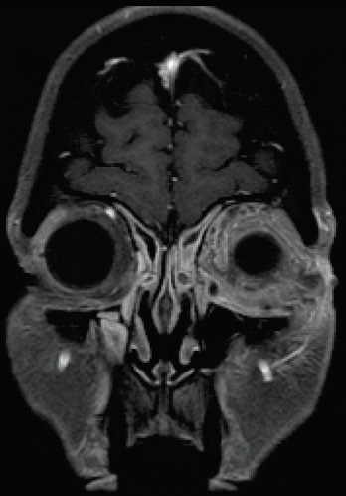
Notes:
1.Diffuse enhancement of the left orbit consistent with cellulitis secondary to sinusitis (coronal T1-weighted MRI)

Slide 13
Medical treatment
Parenteral therapy
Surgical management is indicated if:
1. The patient fails to respond to IV therapy and/or
deteriorates clinically despite appropriate antibiotic
therapy
Notes:
1.until the patient is afebrile and skin changes such as lid edema and erythema have resolved, typically 3 to 5 days. Facilitate sinus drainage
○ Nasal decongestants○ Mucolytics○ Saline irrigations

Slide 14
2. Ocular motility/visual acuity deteriorates
3. Cranial neuropathies develop
4. The patient develops an abscess other than a
small, medially located subperiosteal abscess

Slide 15
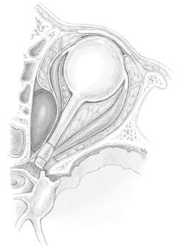
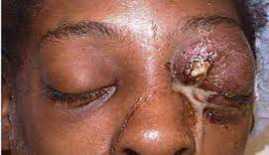
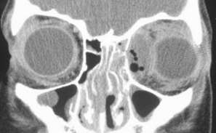
Subperiosteal abscess (Chandler class III)
Pus between the orbital periosteum and the bony orbital wall
Typically between the lamina papyracea and the medial periorbita
Notes:
1.pushing the orbital contents inferiorly and laterally

Slide 16
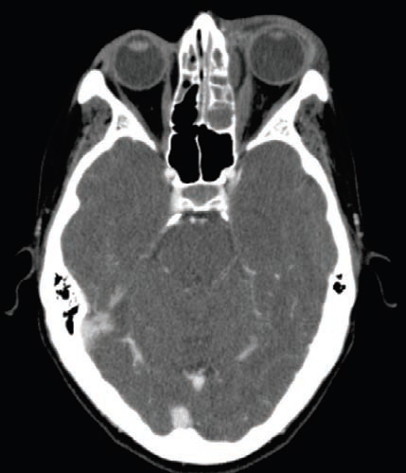
Notes:
1. Axial CT- associated left proptosis, enlargement of the left medial rectus muscle, and left ethmoid opacification
2. With advancing infection, ocular mobility and visual acuity are affected, and chemosis develops. The abscess may penetrate through the periosteum into the orbit or anteriorly into the eyelid.

Slide 17
Medial subperiosteal abscess: Endoscopic drainage combined with an external approach
Laterally seated subperiosteal abscess: Decompression and drainage of the orbit through an external approach
Notes:
May be treated medically in 50-67%, Combined treatment 95-100%○ Meta-analysis cure rate 26-93% (Coenraad 2009). Approaches○ External ethmoidectomy (Lynch incision) is most preferred○ Transcaruncular approach

Slide 18
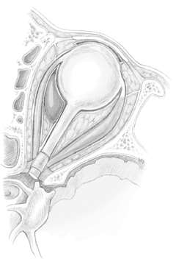
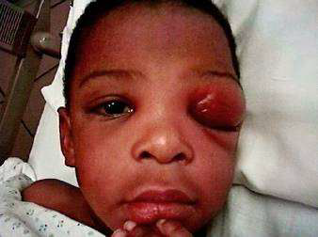
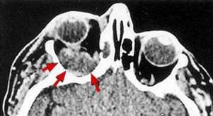
Orbital abscess (Chandler class IV)
Extraconal (between the periosteum and the
extraocular muscles)
Intraconal (located centrally within the muscle cone)
Notes:
proptosis, a limitation of extraocular movement,and visual loss.

Slide 19
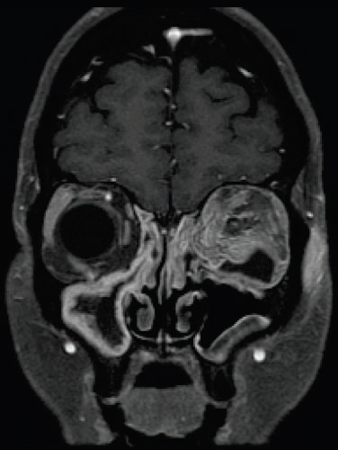
Notes:
(coronal T1-weighted MRI post- gadolinium) diffuse enhancement of the left orbit (cellulitis) with a low density area (fluid) within the inferolateral orbit consistent with an intraorbital abscess

Slide 20
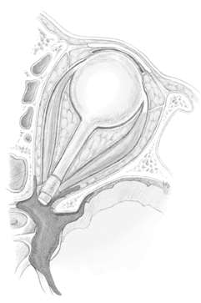
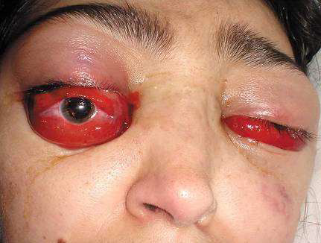
Cavernous sinus thrombosis, or CST (Chandler class V)
Proptosis (often Bilateral)
Chemosis
Progressive opthalmoplegia
Complete loss of vision
Notes:
Animal experiments have demonstrated that visual loss may be irreversible if retinal ischaemic time exceeds 100 minutes. Progress ophalmo-lateral gaze affected first

Slide 21
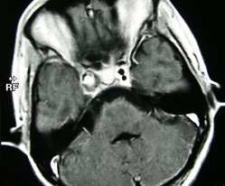
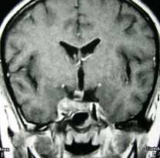
(A)
(B)
Notes:
MRI findings of heterogeneity and increased size

Slide 22
Treatment
Mortality rate up to 30%
Surgical drainage
Intravenous antibiotics
High-dose
Cross blood-brain barrier
Anticoagulant use is controversial
Prevent thrombus propagation
Risk intracranial or intra-orbital bleeding
Notes:
Following surgery, a prolonged course (6 weeks) of culture-directed antibiotic therapy.

Slide 23
PROGNOSIS
If prompt treatment is carried out with adequate monitoring of patients during treatment, the prognosis for the return of normal vision is excellent.
However, there is a small, but significant risk of diplopia following surgery

Slide 24
Intracranial
Pathogenesis: two major mechanisms
Direct extension
Retrograde thrombophlebitis via the valveless diploic veins
Notes:
1.osteomyelitis and subsequent erosion, If infection reaches the subdural space- spreads convexities of the brain because of the lack of septations. The implantation of the arachnoid granules-barrier

Slide 25
Five types
Meningitis
Epidural abscess
Subdural abscess
Intra-cerebral abscess
Cavernous sinus, venous sinus thrombosis

Slide 26
Clinical features
Nausea and vomiting, neck stiffness, and altered mental state.
Increased ICP, meningeal irritation, and focal neurologic deficits, including CN III, VI, and VII palsies
Notes:
Common signs and symptoms○ Fever (92%)○ Headache (85%)○ Nausea, vomiting (62%)○ Altered consciousness (31%), seizure

Slide 27
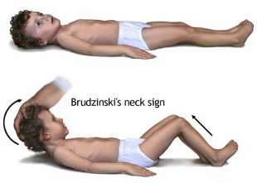
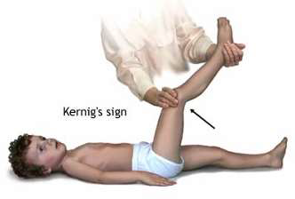
Meningitis
Notes:
Usually amenable with medical treatment Drain sinuses if no improvement after 48 hours

Slide 28
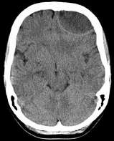
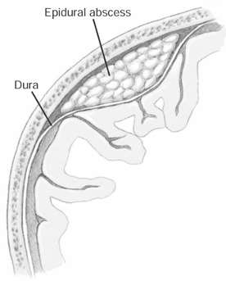
Epidural Abscess
Frontal sinusitis
Notes:
Symptoms, Crescent-shaped hypodensity on CT. It typically occurs just posterior to the frontal sinus, where free venous communication and loose dura
predispose it to abscess formation between the dura and the cranial vault.

Slide 29
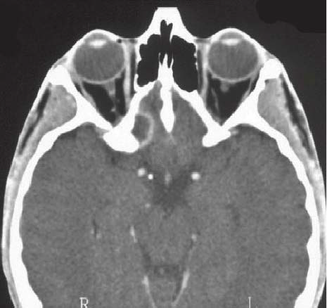
Notes:
Subdural empyemas (41 to 67%) result from sinusitis. Extradural empyema of (L) planum sphenoidale.

Slide 30
Treatment
Antibiotics
Drain sinuses and abscess
Frontal sinus trephination
Frontal sinus cranialization
Stereotactic-guided drainage
Notes:
antibiotics for 4-8 weeks; usually vancomycin and 3rd or 4th generation cephalosporin

Slide 31
Subdural Abscess
Third-most common intracranial complication, rapid deterioration
Mortality in 25-35%
Residual neurologic sequelae in 35-55%
Notes:
Hemiparesis○ Lethargy, coma

Slide 32
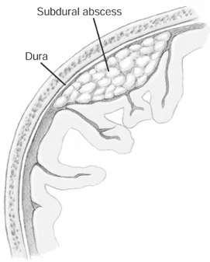
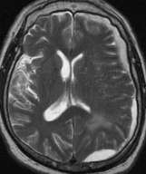
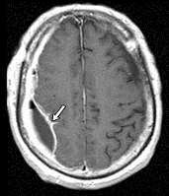

Slide 33
Treatment
Medical therapy (< 1.5cm)
Antibiotics
Anticonvulsants
Mannitol
Steroids

Slide 34
Surgical
Drain sinuses and abscess
Craniotomy or stereotactic burr hole

Slide 35
Intra-cerebral Abscess
Clinical features
Headache (70%)
Mental status change (65%)
Focal neurological deficit (65%)
Fever (50%)
Mortality 20-30%
Neurologic sequelae 60%

Slide 36
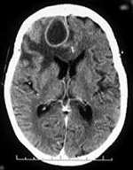
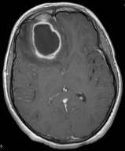
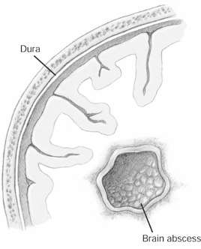

Slide 37
Treatment
Medical
Antibiotics, Anticonvulsants
Mannitol
Steroids
Surgical
Bur hole drainage, craniotomy, or image-guided aspiration
Notes:
Antibiotic 6-8 weeks; typically ceftriaxone, vancomycin or nafcillin, and metronidazole. Corticosteroid use is controversial. Steroids can retard the encapsulation process, increase necrosis, reduce antibiotic penetration

Slide 38
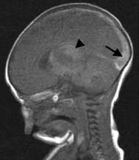
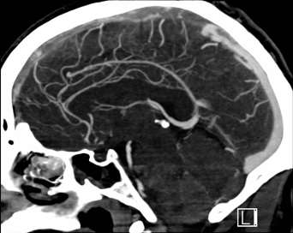
Venous Sinus Thrombosis
Sagittal sinus most common
Retrograde thrombophlebitis from frontal
sinusitis
Extremely ill
Increased mortality

Slide 39
Aggressive medical therapy
Anticoagulation controversial
Thrombus resolution by 6 weeks
Drain sinuses
External
Endoscopic
Notes:
Heparin inpatient, warfarin outpatient

Slide 40
Bony Complications
Pott’s puffy tumor
Frontal sinusitis with acute osteomyelitis
Subperiosteal pus collection leads to “puffy” fluctuance
Notes:
Sir Percivall Pott described Pott's Puffy tumor in 1768 as a local subperiosteal abscess due to frontal bone suppuration resulting from trauma

Slide 41
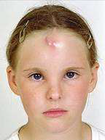
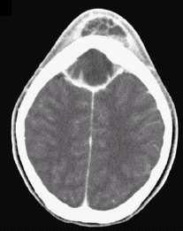
Clinical features
Periorbital or frontal swelling
Notes:
Headache○ Fever○ Neurologic findings○ Periorbital or frontal swelling

Slide 42
Surgical and medical therapy
Drain abscess and remove infected bone
Intravenous antibiotics for six weeks
May obliterate frontal sinus to prevent
recurrence

Slide 43
References
Scott brown

Slide 44
THANK YOU

